Slide 1

Global Health Statistic
Power BI-Reinforcement-Project

Slide 2

What is Power BI?
Power BI is a business intelligence and data visualization tool developed by Microsoft. It is designed to help businesses transform raw data from various sources into meaningful and interactive insights. Power BI is a collection of software services, apps, and connectors that work together to turn your unrelated sources of data into coherent, visually immersive, and interactive insights.
Power BI lets you easily connect to your data sources, visualize and discover what's important, and share that with anyone or everyone you want.

Slide 3
How many chart type in Power BI?
1. Bar and Column Charts
Clustered Bar/Column Chart – Compare multiple categories side by side.
Stacked Bar/Column Chart – Show part-to-whole relationships.
100% Stacked Bar/Column Chart – Display percentage contributions.
Usage: Sales comparison, revenue by region, product category performance.
2. Line and Area Charts
Line Chart – Show trends over time.
Stacked Area Chart – Highlight cumulative trends.
100% Stacked Area Chart – Display proportional trends.
Usage: Sales trends, stock price movement, website traffic analysis.
3. Pie and Donut Charts
Pie Chart – Show proportions within a dataset.
Donut Chart – Similar to a pie chart but with a hole in the center.
Usage: Market share, budget breakdown, sales distribution.
4. Combo Chart
Line and Clustered/Stacked Column Chart – Combine different data types in one chart.
Usage: Compare revenue (bar) with growth rate (line).
5. Scatter and Bubble Charts
Scatter Chart – Show relationships between two numerical variables.
Bubble Chart – Like a scatter chart but with an added dimension (bubble size).
Usage: Correlation between sales and customer satisfaction, risk analysis.

Slide 4
6. Map Charts
Filled Map (Choropleth Map) – Display values across geographic regions.
Bubble Map – Show data points on a map with varying sizes.
Usage: Sales by country, store locations, population distribution.
7. Funnel Chart
Shows a process in stages, such as conversion rates.
Usage: Sales pipeline, customer journey analysis.
8. Gauge Chart
Displays progress toward a goal.
Usage: KPI tracking, business performance monitoring.
9. Waterfall Chart
Shows how an initial value changes with positive and negative influences.
Usage: Profit and loss statements, revenue breakdown.
10. Tree map
Hierarchical data visualization using nested rectangles.
Usage: Product category sales, budget allocation.
11. Matrix and Table
Table – Displays raw data.
Matrix – Like a pivot table, allowing drill-down.
Usage: Detailed financial reports, sales data breakdown.
12. KPI Visual
Shows a key metric with progress toward a target.
Usage: Performance tracking, goal monitoring.

Slide 5
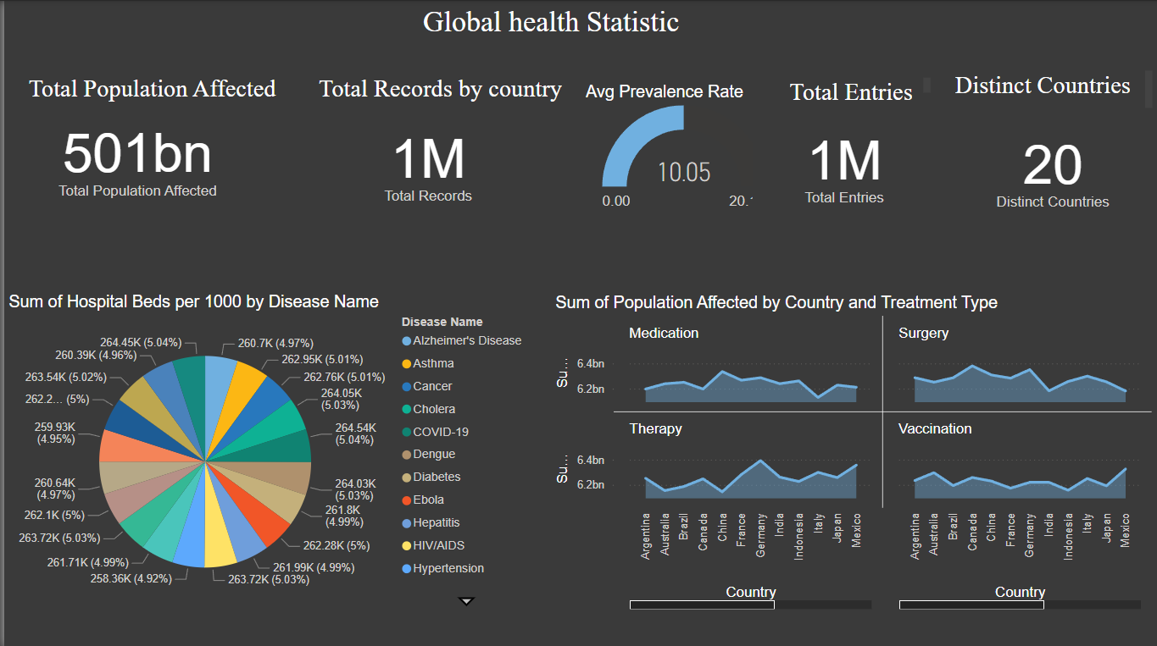
Total Population Affected: 501 billion (likely cumulative across regions).
Total Records by Country: 1 million health records collected.
Average Prevalence Rate: 10.05% (shown as a gauge chart).
Total Entries: 1 million records processed.
Distinct Countries: Data is from 20 countries.
Pie Chart:
Represents the distribution of hospital beds per 1000 people by disease type.
Different diseases (e.g., Asthma, Cancer, COVID-19, Diabetes).
Line Charts:
Sum of the affected population by treatment type
(Medication, Surgery, Therapy, Vaccination).

Slide 6
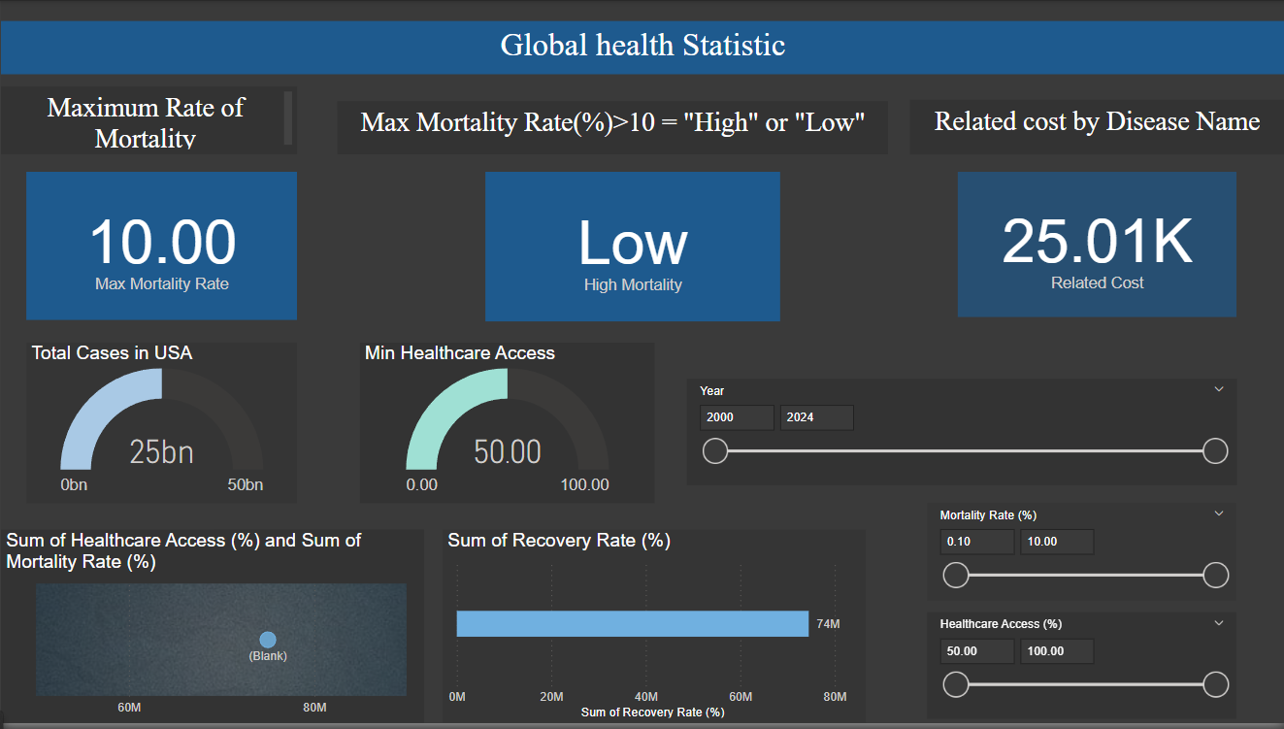
Maximum Rate of Mortality:
10.00% is the highest recorded mortality rate.
Total Cases in the USA: 25 billion cases reported.
Minimum Healthcare Access: The lowest recorded healthcare access is 50%.
Related Cost by Disease Name: The total cost associated
Scatter Plot: Sum of Healthcare Access (%) and Sum of Mortality Rate (%)
Shows the relationship between healthcare access and mortality rate.
Sum of Recovery Rate (%)
Displays total recovery percentage across diseases.
Higher recovery rates suggest better healthcare outcomes.
Year Filter (2000-2024)
Mortality Rate (%) Filter
Healthcare Access (%) Filter

Slide 7
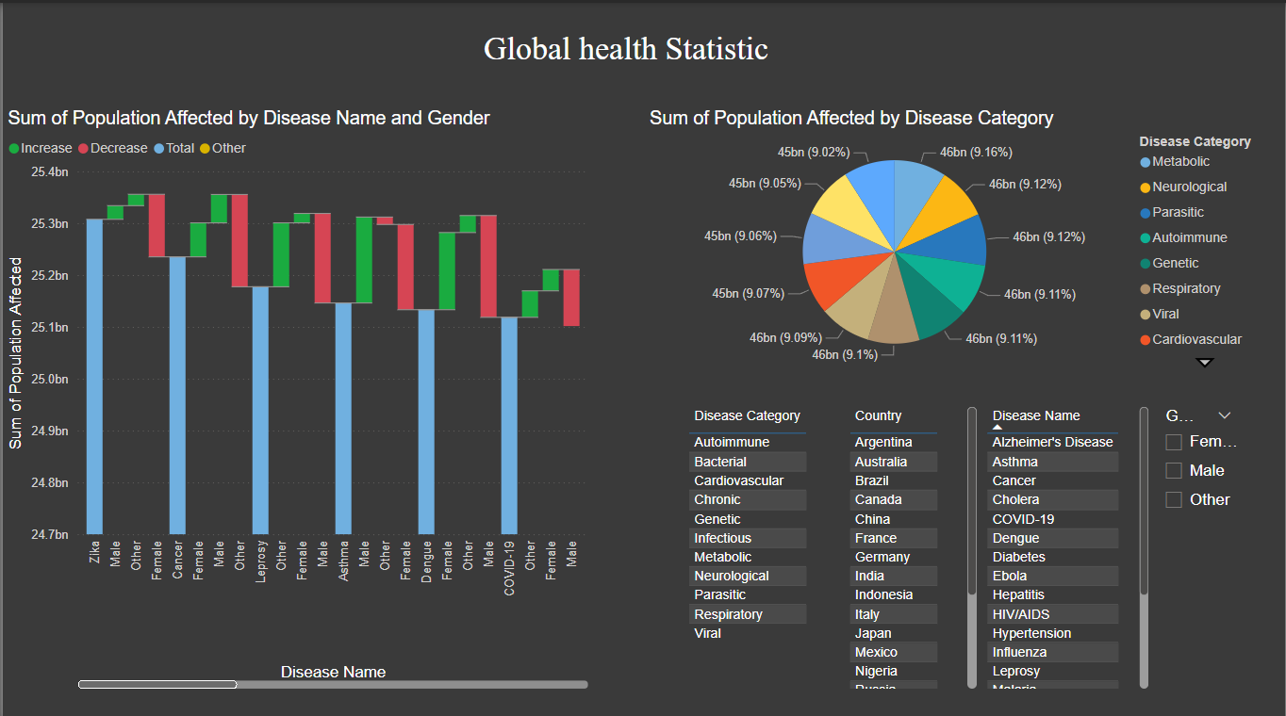
Bar chart visualizing the number of people affected by different diseases, categorized by gender :
Blue bars: Total affected population.
Green bars: Increase in cases.
Red bars: Decrease in cases.
Yellow bars: Other variations.
Shows the distribution of affected population across different disease categories:
Metabolic (e.g., diabetes)
Neurological (e.g., Alzheimer’s)
Parasitic (e.g., Malaria)
Autoimmune (e.g., Lupus)
Genetic, Respiratory, Viral, Cardiovascular, etc.
Each category holds roughly 9-9.1% of the total affected population

Slide 9
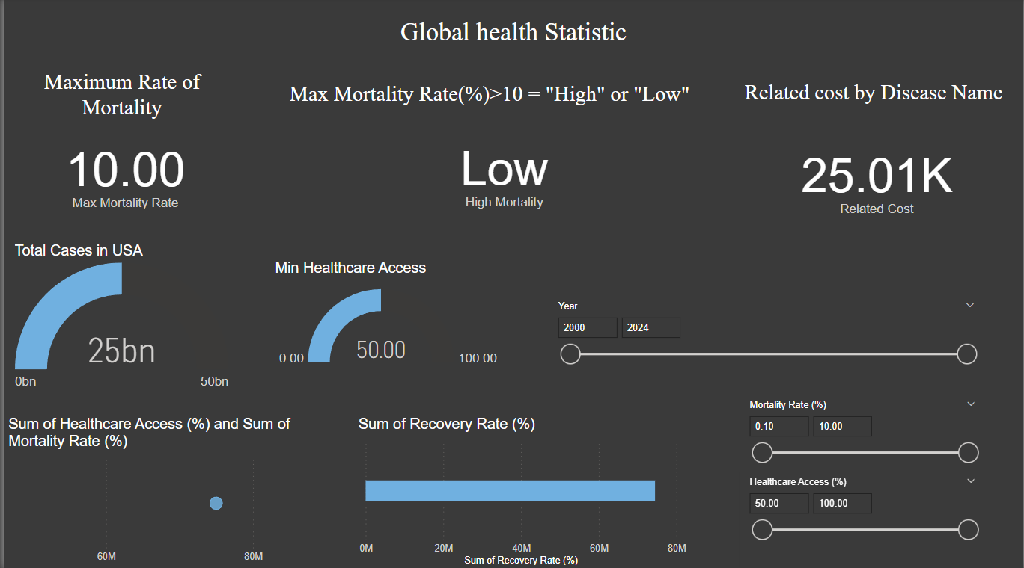

Slide 11
✅ Disease Trends – Different diseases impact genders and regions differently
✅ Mortality & Cost Analysis – Mortality rate is analyzed based on severity, with associated costs for diseases
✅ High Population Impact – 501 billion people are affected globally.
✅ Healthcare Access & Recovery – Some regions have limited access to healthcare, impacting recovery rates

Slide 12

Thank You
SANDHIYA M
DADS

